Slide 1


Introduction to the dsm-firmenich brand
Notes:
Introduction to the company brand, where we will touch on the high level of who we are, our brand identity, and some useful tools and information to help you engage with and represent our brand effectively.

Slide 2
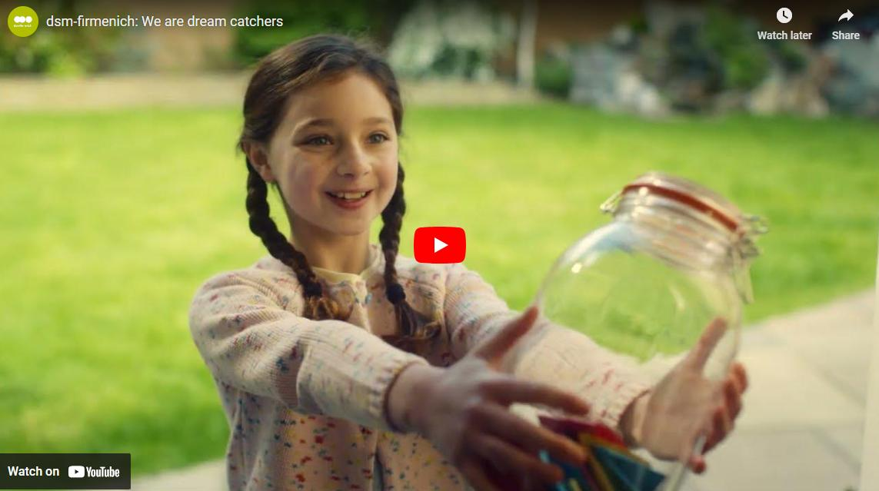
Notes:
Brand film - Dream catchers (hyperlinked to the image – please click on the image to be directed to the YouTube link while in presentation mode)
This video is all about us: what we stand for as a company, the work that we do, the dreams that we have and the dreams we make come true. You are all dream catchers, as together, we make dreams a reality.
At dsm-firmenich, our dream is to bring progress to life by combining the essential, the desirable, and the sustainable. You are all dream catchers, unleashing passionate ideas that heighten the senses and make dreams come true - for ourselves, for our customers, and for the planet.

Slide 3
Topics
01
Introduction & strategy
02
Brand identity
03
Brand support &
brand ambassadorship

Slide 4
01
Introduction &
strategy

Slide 5
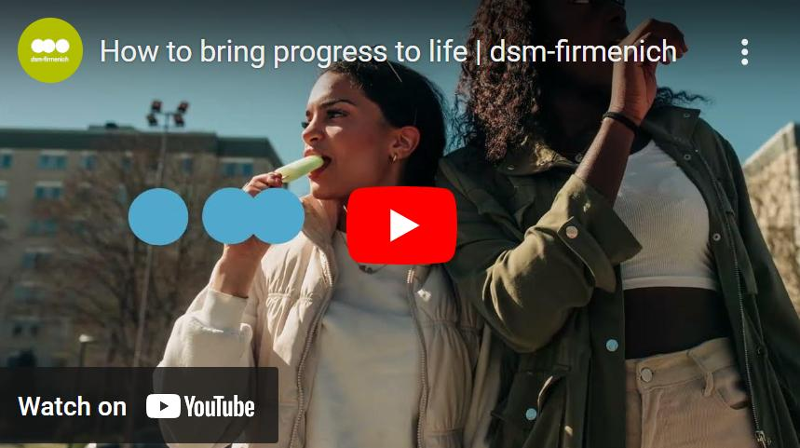
Notes:
(hyperlinked to the image – please click on the image to be directed to the YouTube link while in presentation mode)
This is our brand intro video – that visually presents our vibrant brand

Slide 6
What makes us unique
“All our great products and solutions
bring progress to life, by combining
the Essential, the Desirable and the Sustainable.
We are truly a company in a category of ONE”
Dimitri de Vreeze
Leadership Event
June 2023, Barcelona
Notes:
The first leadership event after the merger happened in Barcelona 2023, and this is what Dimitri said:
“All our great products and solutions
bring progress to life, by combining
the Essential, the Desirable and the Sustainable.
We are truly a company in a category of ONE”

Slide 7
Our purpose
We bring
to life
The Desirable
Want
The Essential
Need
progress
Progress
The Sustainable
Should and Must
Notes:
We have a clear and singular purpose to our brand and business: We bring progress to life.
We can live up to our purpose because we have the unique ability to combine the ”three forces” of the essential, the desirable, and the sustainable. By combining these three forces, we can be a category of one, accelerating progress for people and planet.
It is key in our activities and communications that we think about the forces alongside our purpose.
When we combine the essential, the desirable, and the sustainable, we can solve some of the biggest tensions between what people individually want, what we collectively need, and what our planet demands. It’s what makes us unique, a category of ONE.

Slide 8
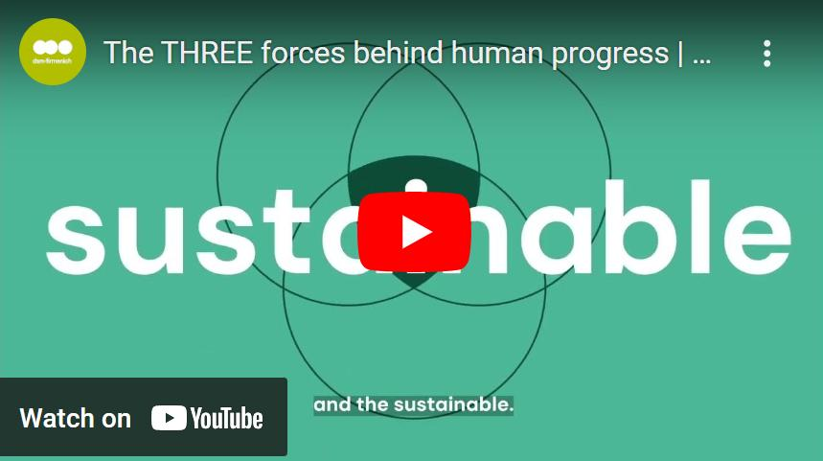
Notes:
(hyperlinked to the image – please click on the image to be directed to the YouTube link while in presentation mode)
Here is another brand intro video – that tells a story of our brand

Slide 9


Brand on a page
Innovators in nutrition,
health, and beauty
Perfumery & Beauty, Health, Nutrition & Care,
Taste, Texture & Health, (Animal Nutrition & Health)
We bring progress to life by combining the essential, the desirable, and the sustainable
Full of life,
in all its glory
Our Expression
Shape the future – Be a force for good – Own the outcome
Together, with our customers
Our Values
Notes:
As a simple summary, here are the core elements of our brand on a single page.
As you work with the brand, please think carefully about how you bring all the elements together into your thinking.
Of particular note is how we combine our purpose with the three forces to create a powerful, ownable, and differentiating connection between not just why we exist as a business (We bring progress to life), but how we deliver it (by uniquely combing the essential, the desirable, and the sustainable).

Slide 10
02
Brand identity

Slide 11
Reflecting brand identity
At dsm-firmenich, we operate as one Masterbrand
to demonstrate that we are one company and underpin our business ambition to be seen as a category of one.
  We communicate as one brand
  Use business unit and group names for navigation purposes only
  Do not create any sub-brands or sub-identities
Notes:
In the strategy intro, you learned that how we combine the 3 forces is what makes us unique at dsm-firmenich.
It’s what makes us a category of ONE.
Therefore, it’s also important that we present ourselves as ONE.
That’s why we operate a Masterbrand to demonstrate that we are one company and a category of one.
It means we communicate as one brand; use our business names for navigation only and do not develop any sub-brands or sub-identifies within the company. We should operate within everything that is available in the brand identity toolbox.

Slide 12

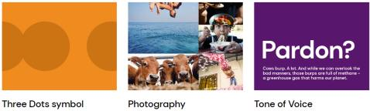
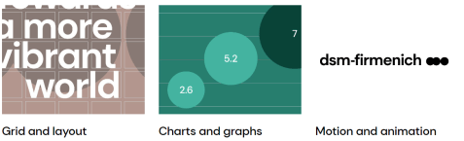
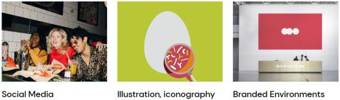
Essential brand guidelines
We have embraced our purpose of
“we bring progress to life” to create a brand that’s full of life, in all its glory.
Our guidelines illustrate where our brand comes to life, both visually and verbally
They provide a foundation for creativity while maintaining brand consistency
By following them, you ensure the dsm-firmenich brand is instantly recognizable wherever it's seen, worldwide
Notes:
We have embraced our purpose of “we bring progress to life” to create a brand that’s full of life, in all its glory.
From logo to color palettes to photography, we have guidelines available based on our purpose and strategy around our branding, to show how and where our brand comes to life visually and verbally.
The combination of your creativity and these guidelines will ensure that wherever anyone sees the dsm-firmenich brand it will be instantly recognizable, all over the world.
They are available on our Brand Center. Please take the time to read them.
These guidelines will be regularly updated, so please always use the Brand Center version to ensure you have all the latest updates.
Today’s focus will be on the most important visual elements: logo, colors, photography and three dots.

Slide 13
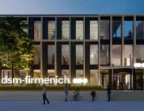

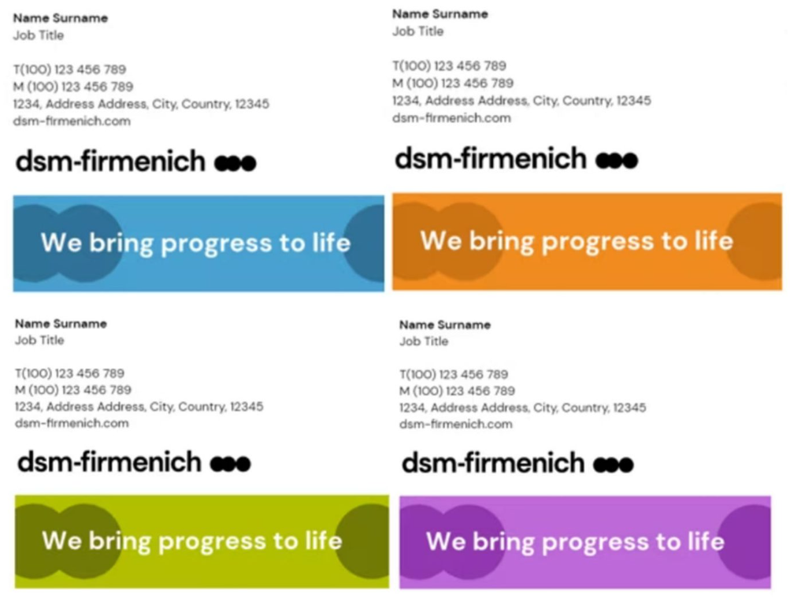

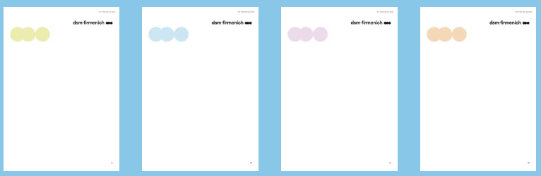




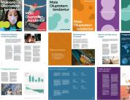
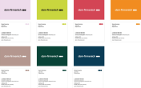

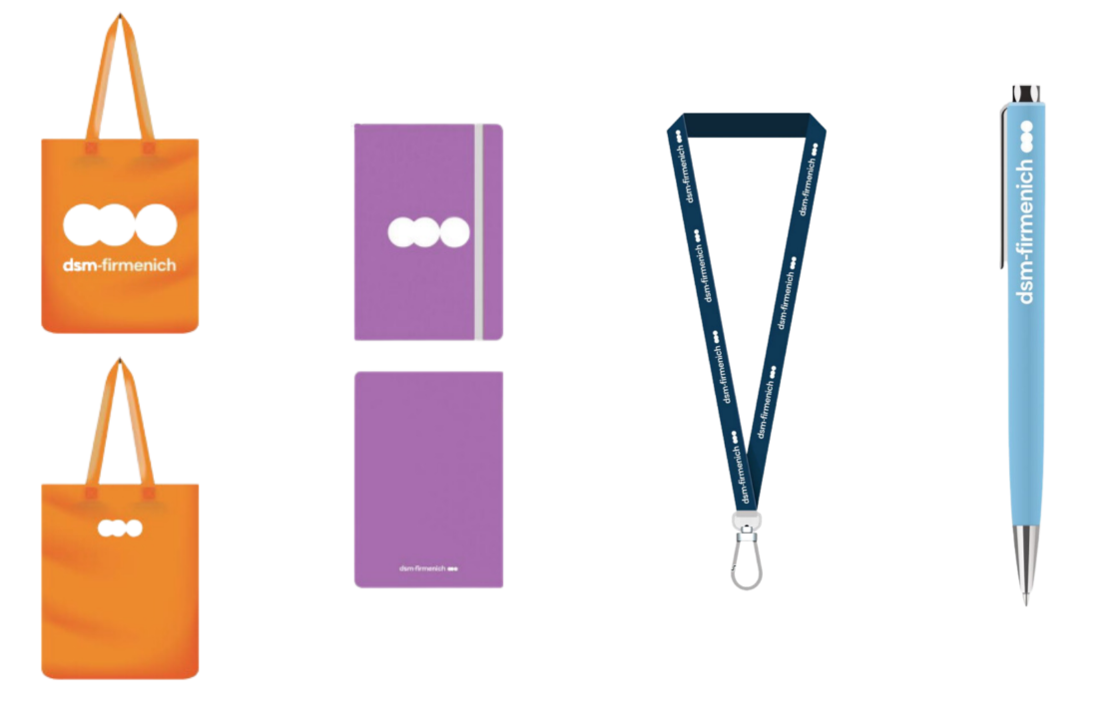
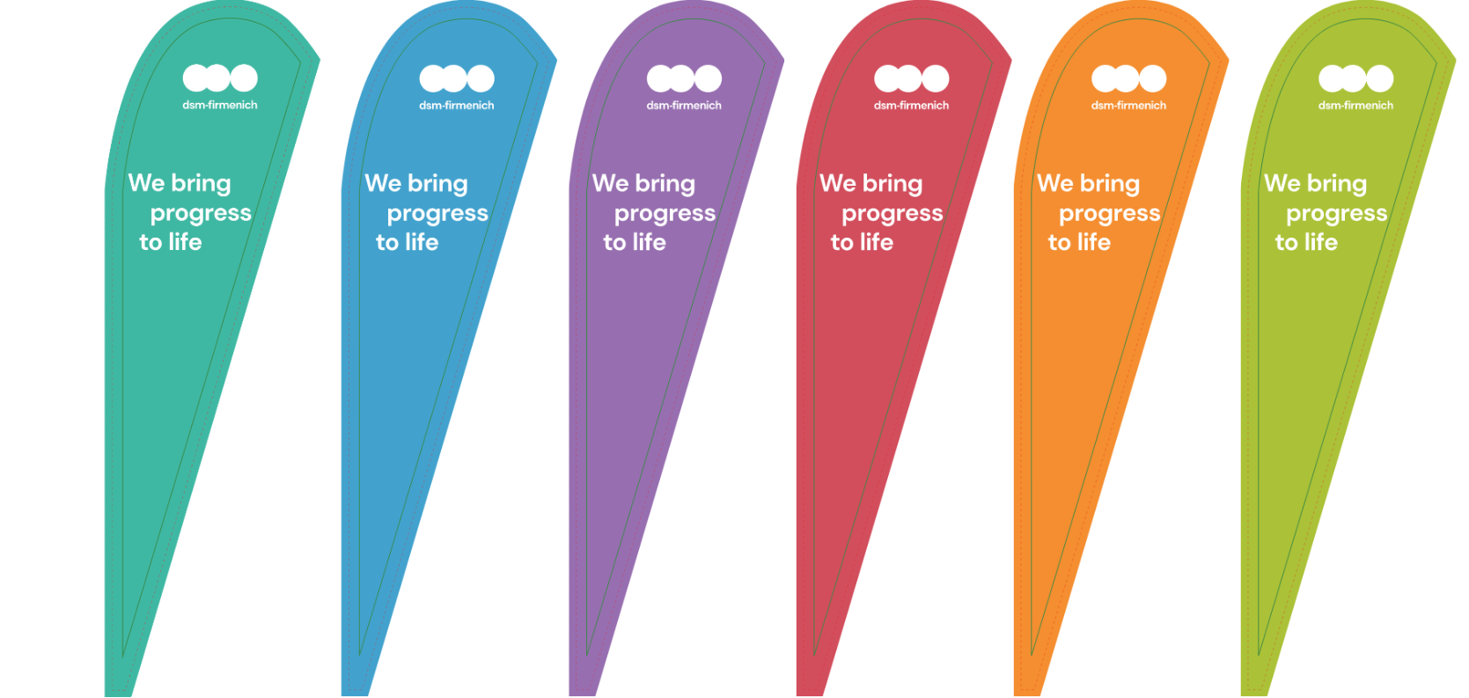

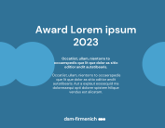
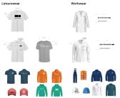
Available templates
Word templates
PowerPoint templates
Teams backgrounds
Email signature
Newsletter
Invitation
Business cards
Posters
Banners
Goodies
Flags
Brochure
Stickers
Certificates
Clothes
Notes:
In addition to guidelines, we also have approved templates to make everyone’s lives easier. From PPT to clothing designs, they are here to help us to properly apply our brand identity elements across all kinds of touchpoints. You can also find these on our Brand Center.

Slide 14
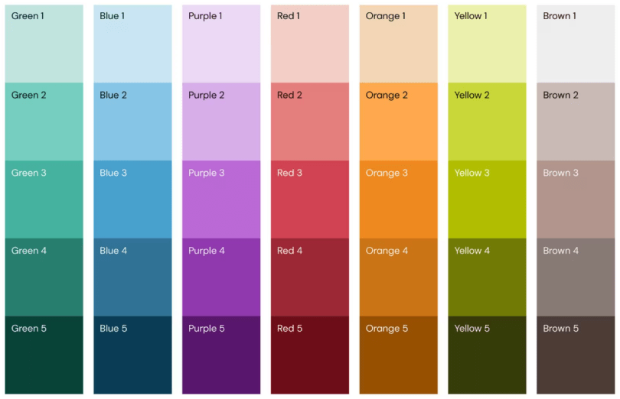











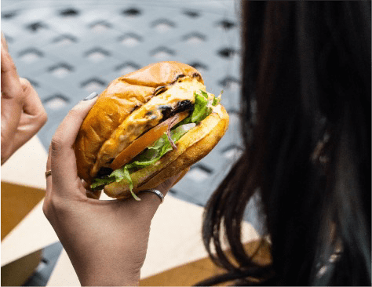












Visual identity elements: how our brand comes to life visually and verbally
Logo
Colors
Typography
DM Sans Verdana
Lora Noto Sans & Noto Serif
Photography
Iconography / illustrations
Tier 1 - Gallery of Life
Tier 2 - Gallery of Life
Tier 3
Three dots
Level 1
All 3 dots are together.
Can be vertical or horizontal.
Level 2
3 dots, 1 is separated.
Can be vertical or horizontal.
Level 3
3 dots in different sizes.
Level 4
6 dots in same or different sizes.
Full color
Outline
Notes:
On this slide you see some of the most important visual elements: logo, colors, photography and three dots that we will discuss a bit further.

Slide 15

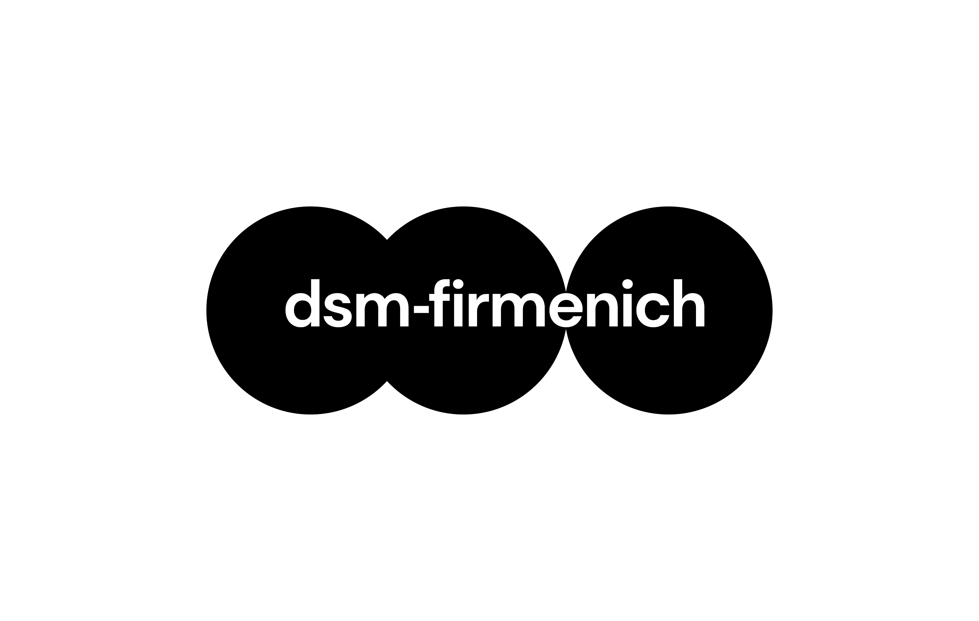
Logo types
The three dots are a symbol of our brand and reflects our purpose.
They represent a visual depiction of our three forces and the constant movement toward bringing progress to life.
Primary
Secondary
Tertiary
Preferred usage
Use when primary logo is not applicable to use
For high visibility materials, with brand team’s approval only
**Logo should be in black or white only**
**Our company name is written: ‘dsm-firmenich’ in lower-case**
Notes:
Our logo is one of our most important brand elements and our most significant visual clue. It is more than just the name of our company, but a symbol for our brand and a reflection of our purpose.
The 3 dots represent a visual depiction of our three forces and the constant movement toward bringing progress to life.
There are three different logo types, and the primary logo is the preferred usage.
The tertiary logo should be used only for high visibility touch points, with Brand Team’s approval.
Common mistakes we see in logo and our company name:
The logos should be used in only black or white
The correct way to write the company name is lowercase ‘dsm-firmenich’ *** please emphasize this ***

Slide 16
Colors
The dsm-firmenich world is about life and progress.
The colors have been inspired by real life to convey the true palette of the world we live in.
Multi colors and different hues should be used on touchpoints (do not assign one specific color to a project or team).
Notes:
The dsm-firmenich world is about life and progress, and it’s our desire is to feel multichromatic, just like life.
The colors have been inspired by real life to convey the true palette of the world we live in.
The color palette is made up of seven colors with five different hues each, to help flex the brand language and meet different context and touchpoint needs.
We should mix colors with different brightness levels will achieve a more diverse and sophisticated look and feel.
You should not color-code, meaning not assigning a specific color to a project or to a team.
You can find exact color references on the Brand Center, as well as some guidance on logo application on color, selection of different colors, and application examples.

Slide 17
























Photography
The dsm-firmenich world is about life and progress.​
Our identity uses real-life imagery with a strong reportage approach to represent the real world we live in – so called the Gallery of Life.
Tier 1 - Gallery of Life
Tier 2 - Gallery of Life
…
…
Tier 3
Notes:
The dsm-firmenich world is about life and progress.​
Our identity uses real-life imagery with a strong reportage approach to represent the real world we live in – so called the Gallery of Life.
To streamline photography, we created a framework indicating the type of images and their specific use. Gallery of life Tier 1 & 2 images are always subjected to global brand approval.
You can learn more about our imagery and the tier system on the Brand Center and we also have an asset library where you can find the approved images.
Please do not use any images that are not aligned with our brand guidelines.

Slide 18







Three Dots
The three dots are a symbol of our brand. They represent our three brand forces and our purpose of bringing progress to life.
Permutation levels
Styles
Don’ts
Level 1
All 3 dots are together.
Can be vertical or
horizontal.
Full color
NO
Don’t use full color dots with outline stoke
NO
Don’t link all three dots
NO
For horizontal lvl 1 & 2, use two dots, then one
NO
Don’t mix full color and outline
Level 2
3 dots, 1 is separated.
Can be vertical or
horizontal.
We bring
progress to life
Level 3
3 dots in different sizes.
Level 4
6 dots in same or
different sizes.
Outline
NO
Dots can’t be used as containers for text
NO
Dots can’t be used as containers for photos
NO
Don’t merge the dots when using outline
NO
At level 1-3, the three dots should be visible
Notes:
The three dots are a symbol of our brand and reflects our purpose.
They represent a visual depiction of our three forces and the constant movement toward bringing progress to life.
That’s why it’s crucial to use the dots correctly
We have 4 different permutation levels when using the three dots, which is a little technical, but you can learn more about it on the Brand Center
There are two styles: full color, and outline
There are example of Don’ts – please see carefully to make sure these do not happen. One important rule is that the 3 dots are not to be used as containers for content (images or text)

Slide 19
03
Brand support &
brand ambassadorship

Slide 20
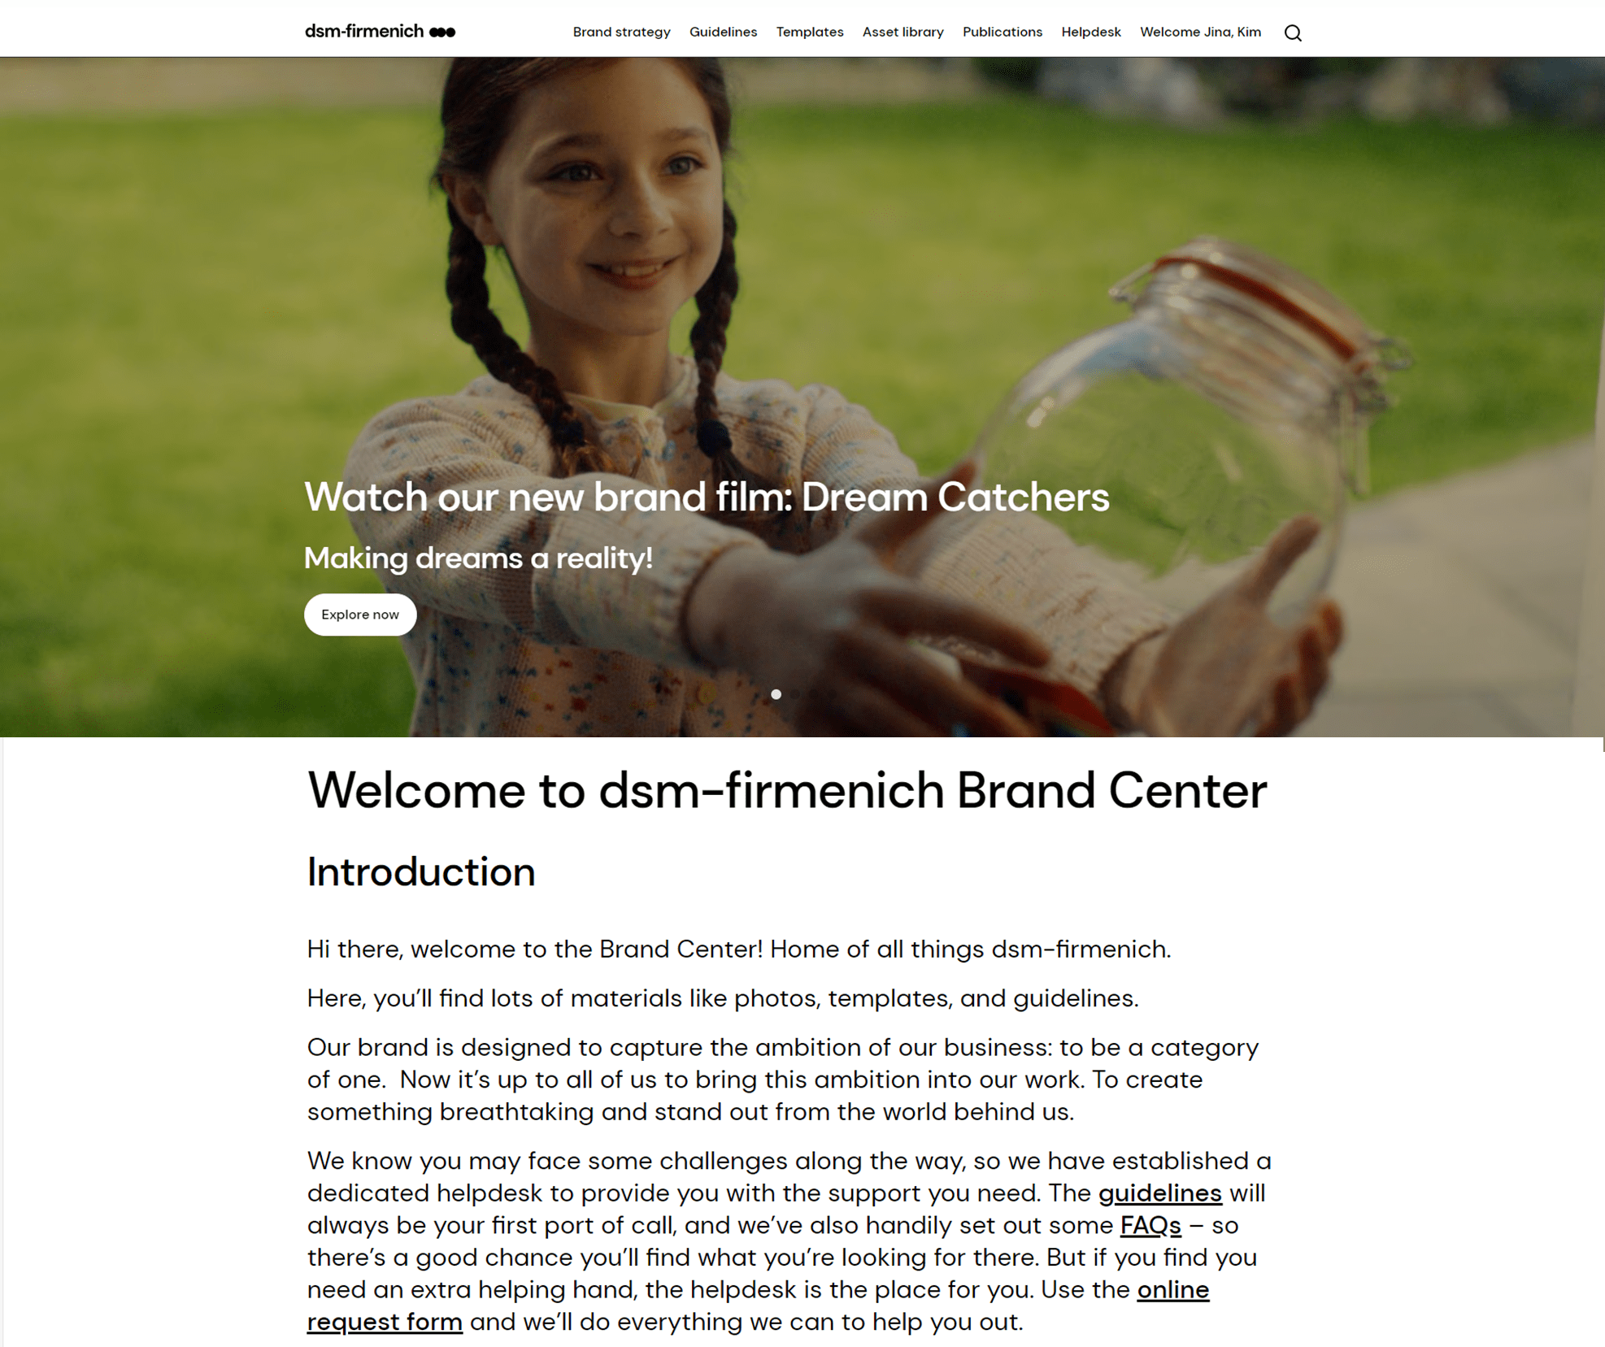
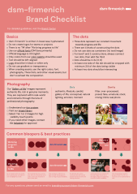
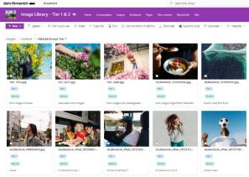
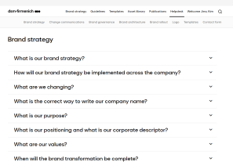
Key links & support
Brand Center
Brand asset library
Brand checklist
FAQ
One-stop shop for all branding resources
Brand-approved photos, footage, and icons
One-pager covering brand essentials
Quick answers to common branding questions
Discover now
Explore now
Learn more
Explore now
If you have any questions or materials to be reviewed,
please contact branding.support@dsm-firmenich.com
Notes:
Here are the key links
Brand Center: where you can find all materials
Asset library: where you can find all images, footages, and icons
Brand Checklist: a one-pager about the basics of brand
FAQ page on the brand center: where you can read more about some of the most commonly asked questions.
If you have any other questions, or need any materials to be reviewed, please contact the brand helpdesk at: branding.support@dsm-firmenich.com

Slide 21
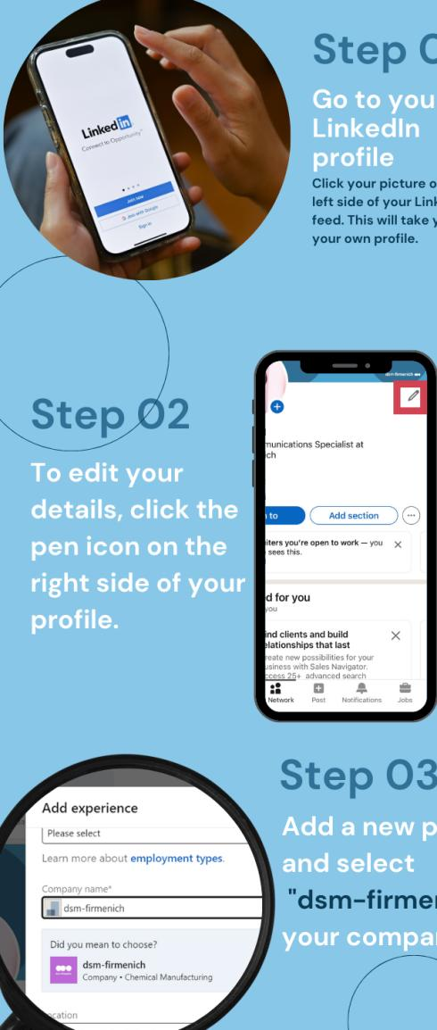
Start embracing the brand!
Download LinkedIn banners here!
Update your employer on LinkedIn
Step 01
Go to your LinkedIn profile
Click your picture on the left side
of your LinkedIn feed.
This will take you to your own profile.
Step 02
Edit your details
Click the pen icon on the right side of your profile
Step 03
Update the company
Add a new position and select “dsm-firmenich” as your company.
Notes:
Your journey at dsm-firmenich is starting, and you can start embracing the brand by updating your employer on LinkedIn.
Here is the how-to.
Step 1 / 2 / 3
Make sure you emphasize again on the company name – it’s lower case ‘dsm-firmenich’.

Slide 22

Curious about the latest brand updates
& trainings?
Send an email to branding.support@dsm-firmenich.com to become part of the Brand Ambassador Community!
Notes:
Also, if you're interested, you can send an email to the Brand Helpdesk to join the Brand Ambassador Community, where you'll receive newsletters and invitations to network calls and trainings to stay updated on the latest developments.

Slide 23
Notes:
Thank you!

