Slide 1
Introduction
In the following pages, you will find a photography brief template that is ready to fill and personalised to your needs.
  Section 1 and 2 provide the context for your partner and should never be removed.
  Section 3 is the core of your brief.
You will find overlayed box messages to guide you through the document.
Please remove them (and this page!) before sharing.

Slide 2
Photography Brief
Title of the Brief

Slide 3
Context
Two companies, DSM and Firmenich are merging.
From a branding perspective, this is the opportunity to create a Category of One, breaking away from the competition.
Photography will be a crucial asset to reach this goal.

Slide 4
01
Our brand

Slide 5
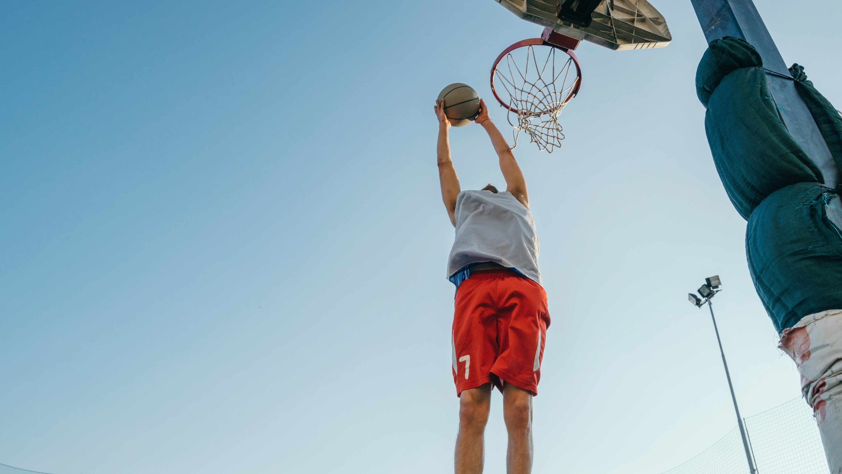

Our strategy
Our purpose
Never before has the world around us been so challenged
to balance what we individually want and what the planet
can provide.
At dsm-firmenich, we can help solve this challenge.
We are able to bring together what we want, what we need, and what the planet demands allowing us to develop better products and solutions for our customers – to drive progress.
We use “life” alongside progress to highlight the positive contribution we make
to our people and our world. Better wellbeing.
Better nutrition. Better health
for people and the planet.
We bring progress to life

Slide 6
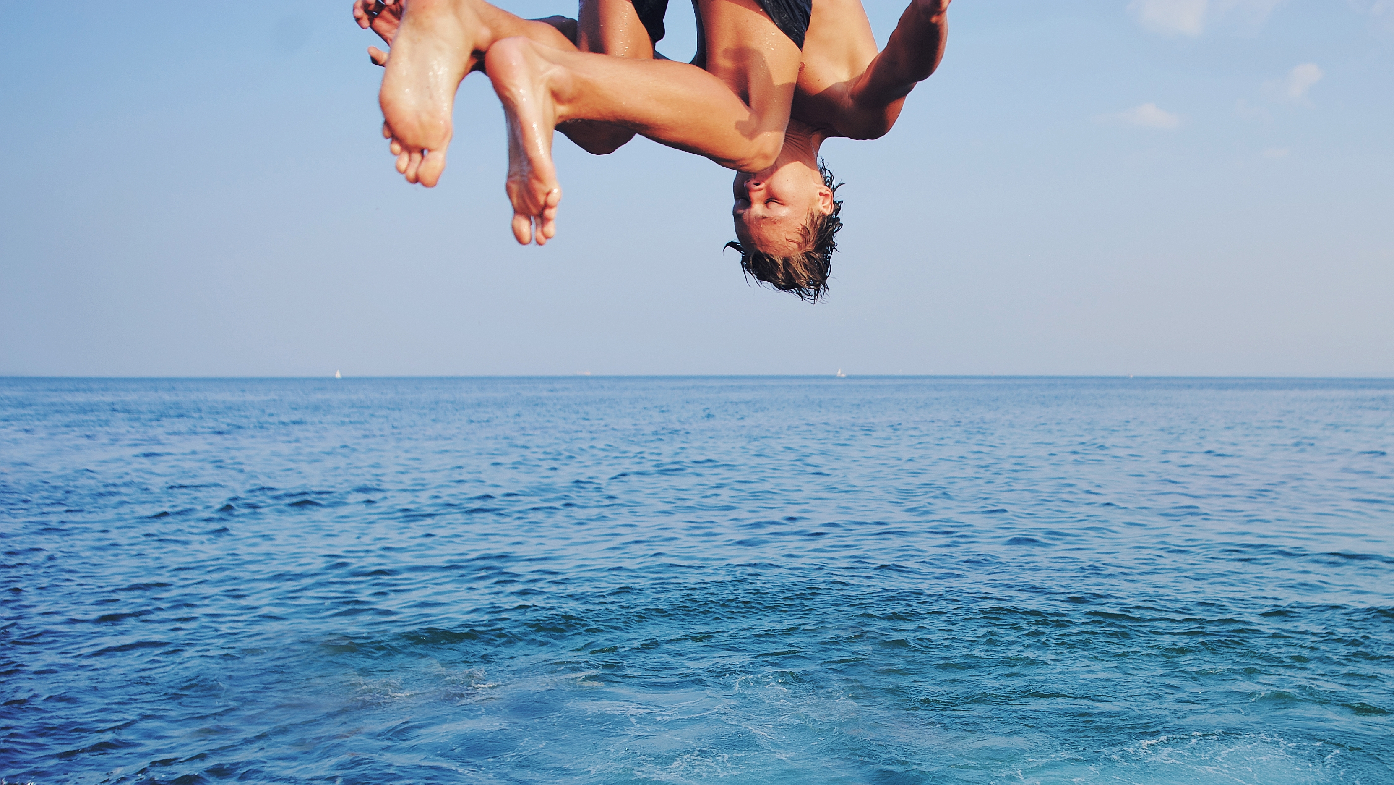
Our strategy
Our story
Our lives are suspended in the rising tension between
what we individually want, what we collectively need –
and what the planet demands.
We believe that progress lies not in sacrifice or compromise,
but in our belief that when human inventiveness embraces
and scales the wonders of nature, a way forward can be
found – combining what's essential, what's desirable
and what's sustainable.
From making nutritious yet appetising food more accessible
to providing solutions so farmers can work better with nature,
from improving the health of millions at every stage of life’s journey
all the way to creating next generation fragrances that feed the soul,
we enrich life for the many while nurturing it for all.
We are two companies coming together as a single force for good.
Uniting science and innovation. And enabling the world's most
admired businesses to help us all thrive.
Together with our partners, we combine
the Essential, the Desirable, and the Sustainable.
Together we bring progress to life.
Together we are dsm-firmenich.

Slide 7
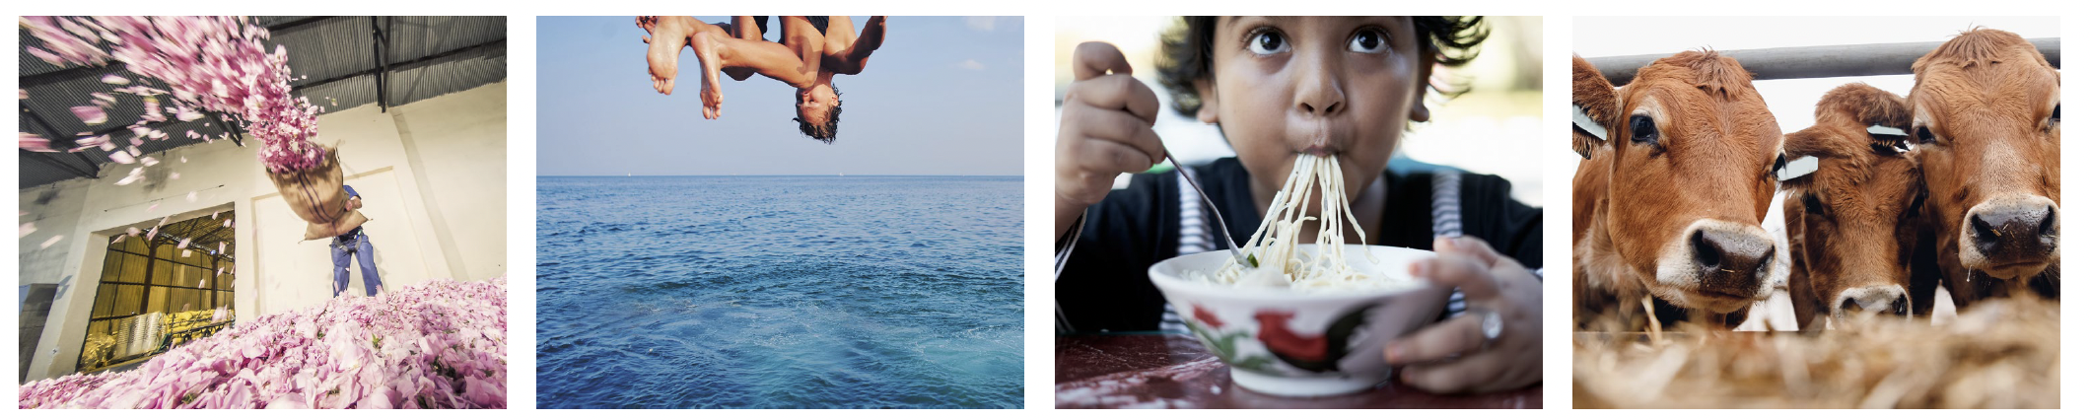
There are 4 BUs in the company
At dsm-firmenich, we operate as a single brand. This ensures that all
the activities we undertake help build equity into one, unified, brand. Although each of our four business units are distinct businesses,
we do not allow them to develop a separate brand or look and feel.
Perfumery
& Beauty
Health, Nutrition
& Care
Taste, Texture
& Health
Animal Nutrition
& Health

Slide 8
02
Our photographic style

Slide 9
Art direction and style
The dsm-firmenich world is about life and progress.
The identity uses lifestyle imagery with a strong reportage approach to represent the real world
we live in.
Goal
Variety:
representing
the whole world
Feel:
authenthic and spontaneous
Style:
color and black
and white imagery
Overall, our photographic style has an important role for our business. To make our brand feel as a category of one—the only brand that is truly in touch with the diversity of the world and understands what we individually want, what we collectively need – and what the planet demands.
Our pictures should be relevant to our business but should never be overly explicit or descriptive.
We seek out and commission high-quality images that are visually stunning, well-composed, and technically proficient.
The images are not only aesthetically pleasing, but also capture the essence of our business and the key overall message we want to convey:
we bring progress to life.
Our goal is to showcase a diverse representation of ethnicities and cultures in our images.
By doing so, we hope to foster open and constructive conversations that broaden society's understanding of various groups of people around the world—and their needs and desires.
We look for candid, natural shots that capture the subject in their true, unposed state. We aim to capture the subject's true personality and emotions, rather than forcing them into a preconceived pose or setting.
This style of photography is often associated with photojournalism and street photography and is highly valued for its ability to tell a story and convey emotion through the image.
We should strive for a balance between post-processing and authenticity.
While post-processing can be a powerful tool for enhancing and refining an image, it is important to remember that excessive post-processing can detract from the authenticity and naturalness of the photograph.
Our brand relies on both color and black and white images.
Color photography can accurately depict the world as seen by the human eye and create striking,
vibrant images. It can also evoke a sense of warmth and cheerfulness.
Black and white photography, on the other hand, can convey a sense of timelessness and highlight the composition and tonal range of an image.
We encourage choosing and commissioning both styles and juxtaposing them when creatively possible to create a sense of variety.

Slide 10
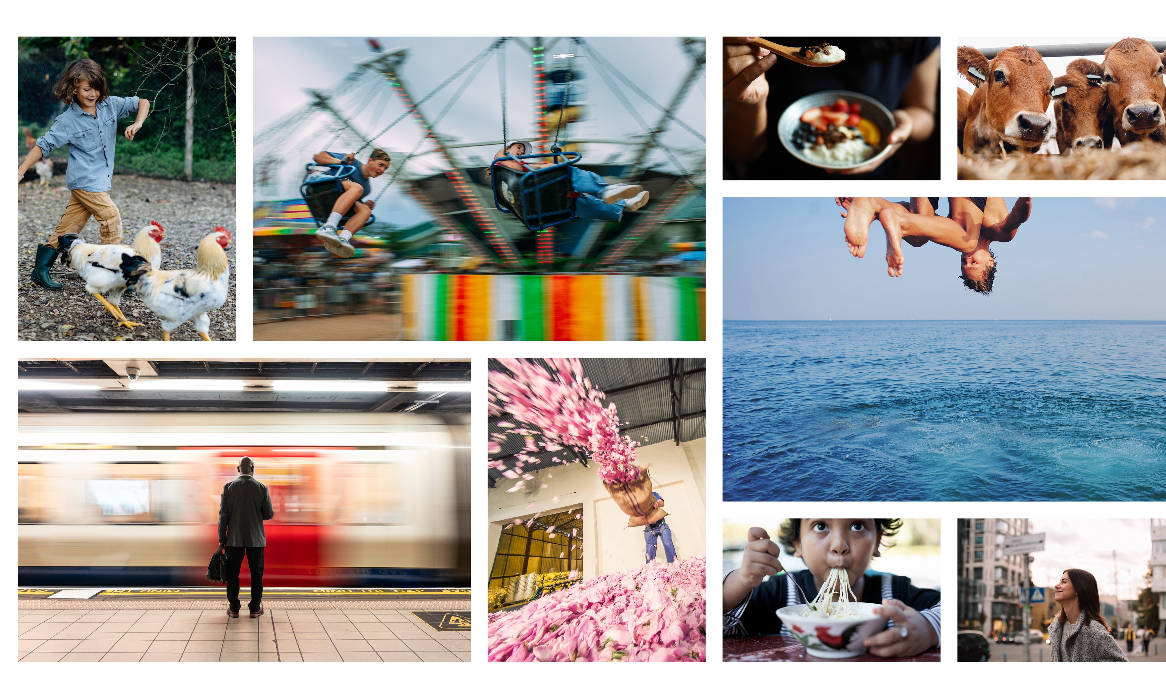
Our inspiration
Here're a range of
on-brand photography examples.

Slide 11
Key elements of our photographic style
Subjects should be in their true, unposed state, effectively communicating genuine emotions
(e.g. no fake smiles).
People should appear at ease, effortlessly blending
into the scene.
Composition should be clear and well-considered.
Diversity should be considered across the brief. Please explore the possibility of representing variety by considering dimensions such as age, genders, abilities, ethnicities, and cultures individually.

Slide 12
Key elements of our photographic style
Technical speces
Color should be natural, with bright lighting.
Flash lighting is acceptable if it fits naturally within the scene.
Images could be in both color and black-and-white photography.
Some of the images (but not all) should include a segment that makes it easy to overlay text, such as headlines.

Slide 13
Key elements of our photographic style
Things to avoid
Pictures should always look natural without evident color shifts, such as excessive saturation, extreme contrast, and overexposure.
Avoid forced perspective, lens distortions,
or camera angles other than overhead
or front view.
Avoid clichés or overly exaggerated expressions.
Don't use photos that look staged.
Avoid images with chaotic and poorly composed arrangements.

Slide 14
03
Your brief

Slide 15
The brief
Who
An example:
The brief
Who
Multicultural people in a group (up to 3 or 4) of any age. Would like to have a representation of people of different genders and ages across the photos.
This is just an illustrative example.
Please delete this box before sending
the brief.
This section is dedicated to defining the ‘who’ for your brief.
Specify the intended audience
for the photos. Clearly outline
the demographic details, including whether the focus is on a group
or individual, and provide specifics regarding gender and ethnicity.
An example:
Science-led nutrition supporting:
wellbeing, menthal and physical, through lifestages
the performance of active people (and athletes, to a lesser degree)
This is just an illustrative example.
Please delete this box before sending the brief.

Slide 16
The brief
What
An example:
The brief
What
Eating/enjoying healthy food and drinks. Preferably the following food applications:
  Beverages: Energy drinks, sports drinks, enhances waters, coffee & tea
Please avoid food that looks unhealthy, like very greasy looking food.
Clear view of the food and drinks, but no brand logos present.
This is just an illustrative example.
Please delete this box before sending
the brief.
This section is dedicated to defining the ‘what’ for your brief.
Specify what is intended to be represented in the photo shoot. Examine the content of the photos in detail, aiming to clearly outline
the necessary elements and those to avoid.
This is just an illustrative example.
Please delete this box before sending the brief.

Slide 17
The brief
Where
An example:
The brief
Where
Outdoors, natural setting. Could be on a patio, park, nature.
This is just an illustrative example.
Please delete this box before sending
the brief.
This section is dedicated to defining the ‘where’ for your brief.
To accurately specify the context, whether outdoors or indoors, within a natural environment or an urban setting, in which the photo shoot is intended to take place.
This is just an illustrative example.
Please delete this box before sending the brief.

Slide 18

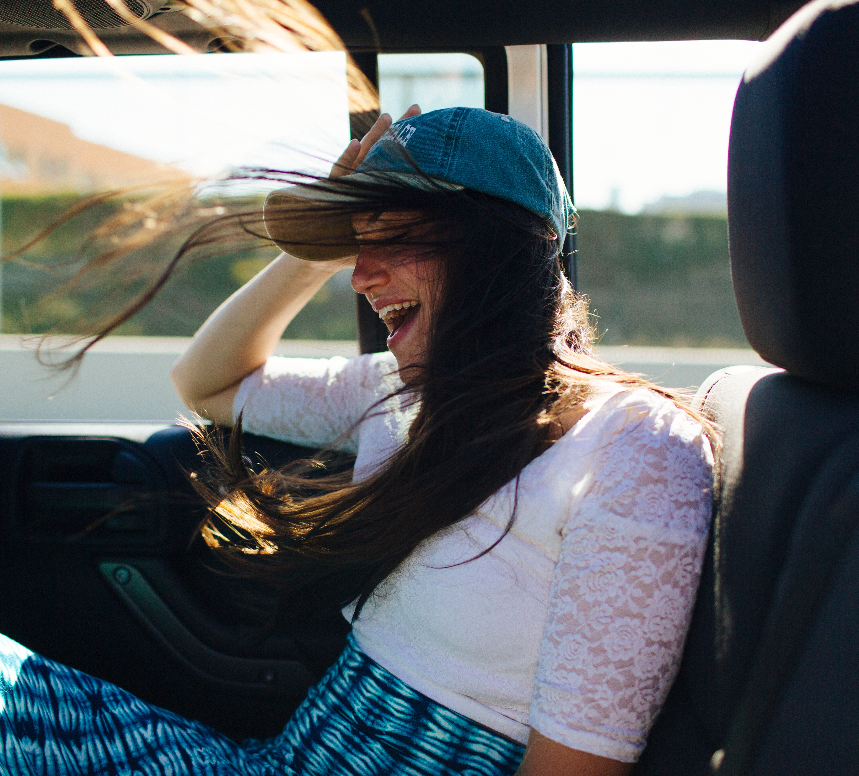
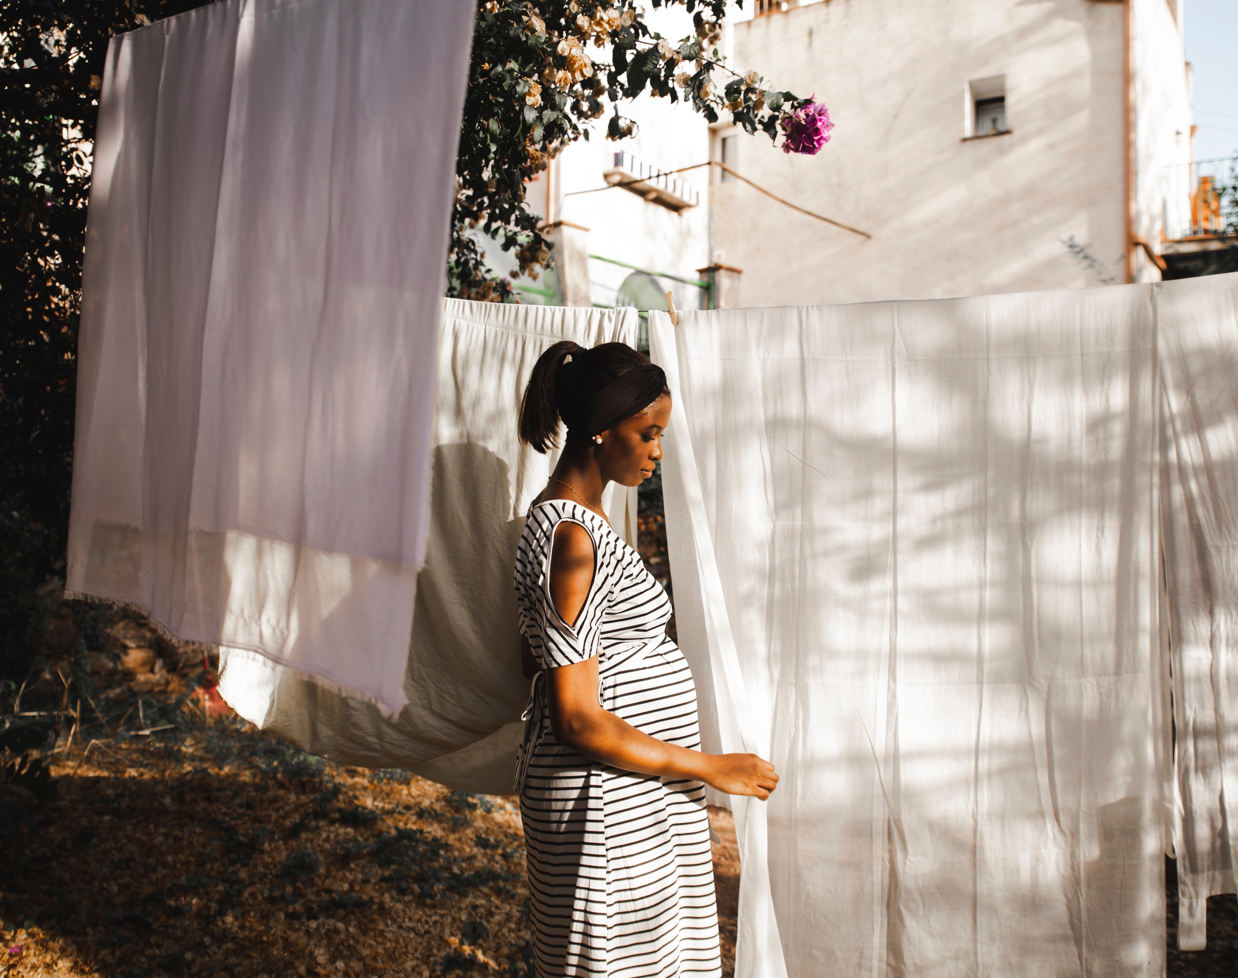
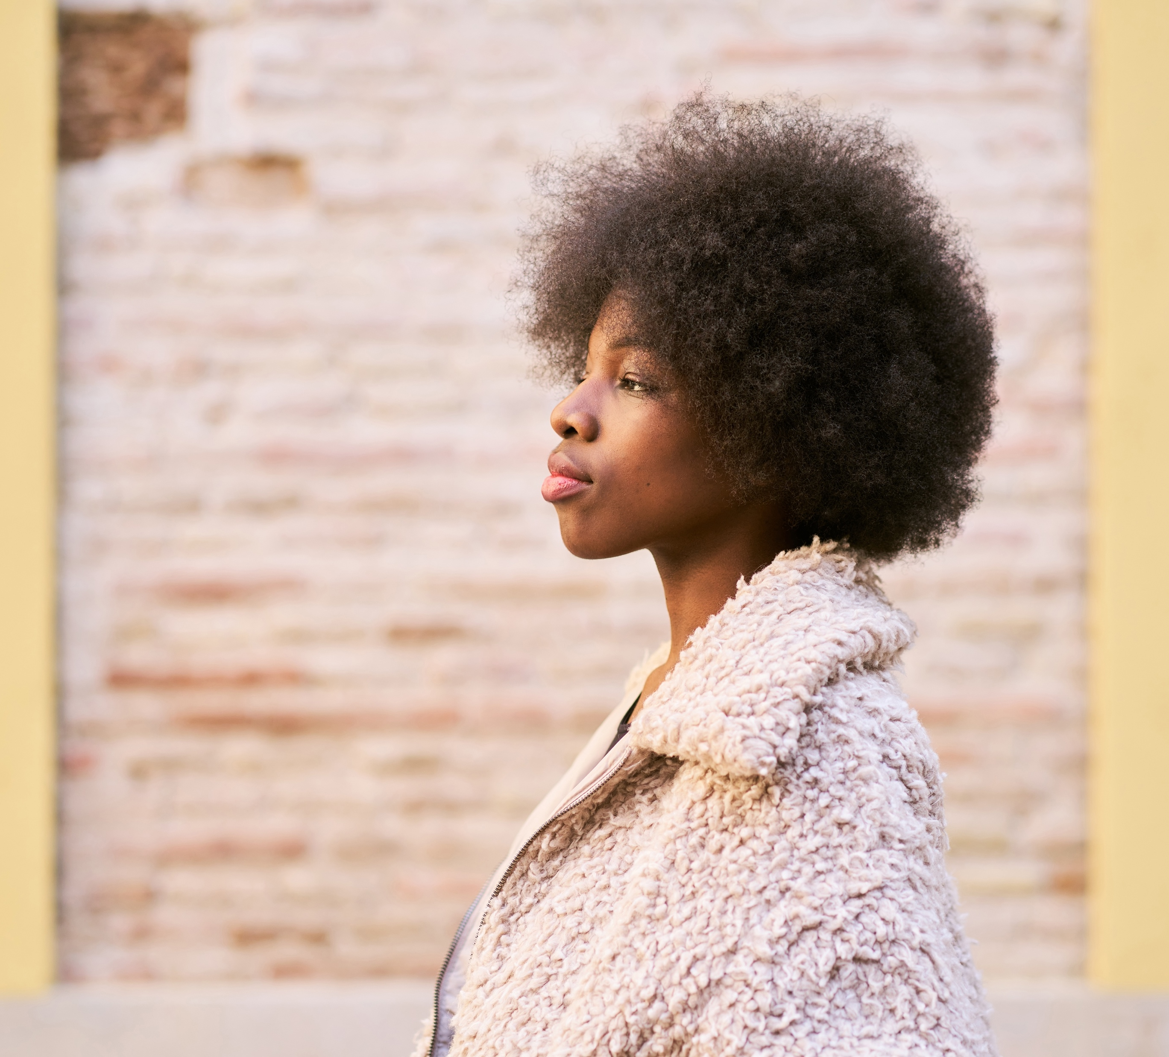
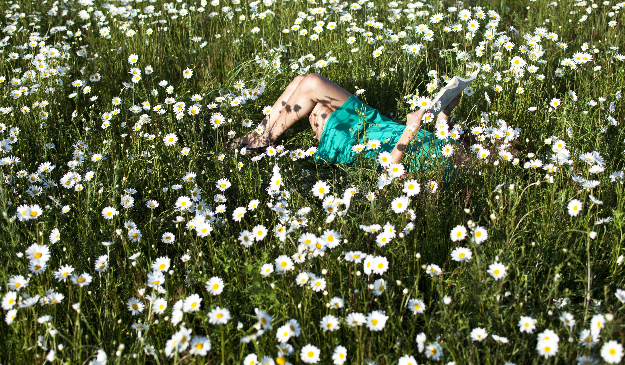
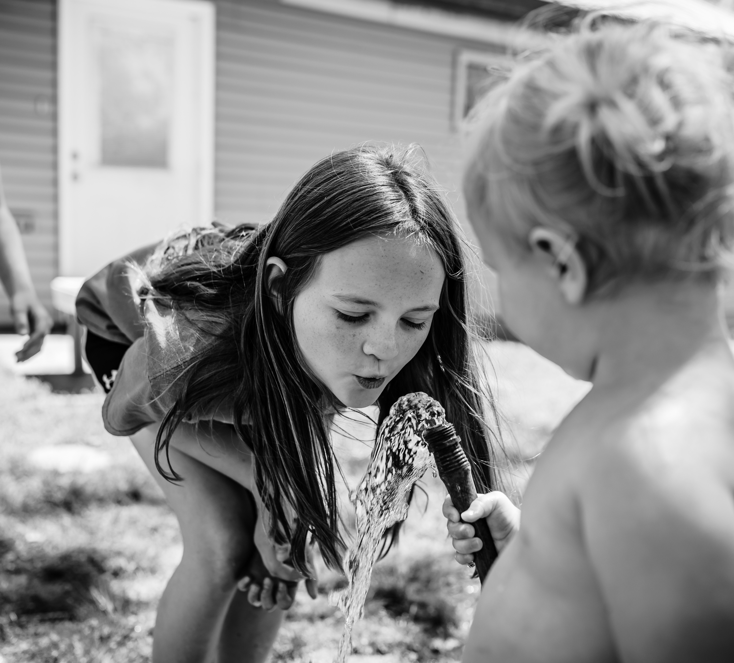


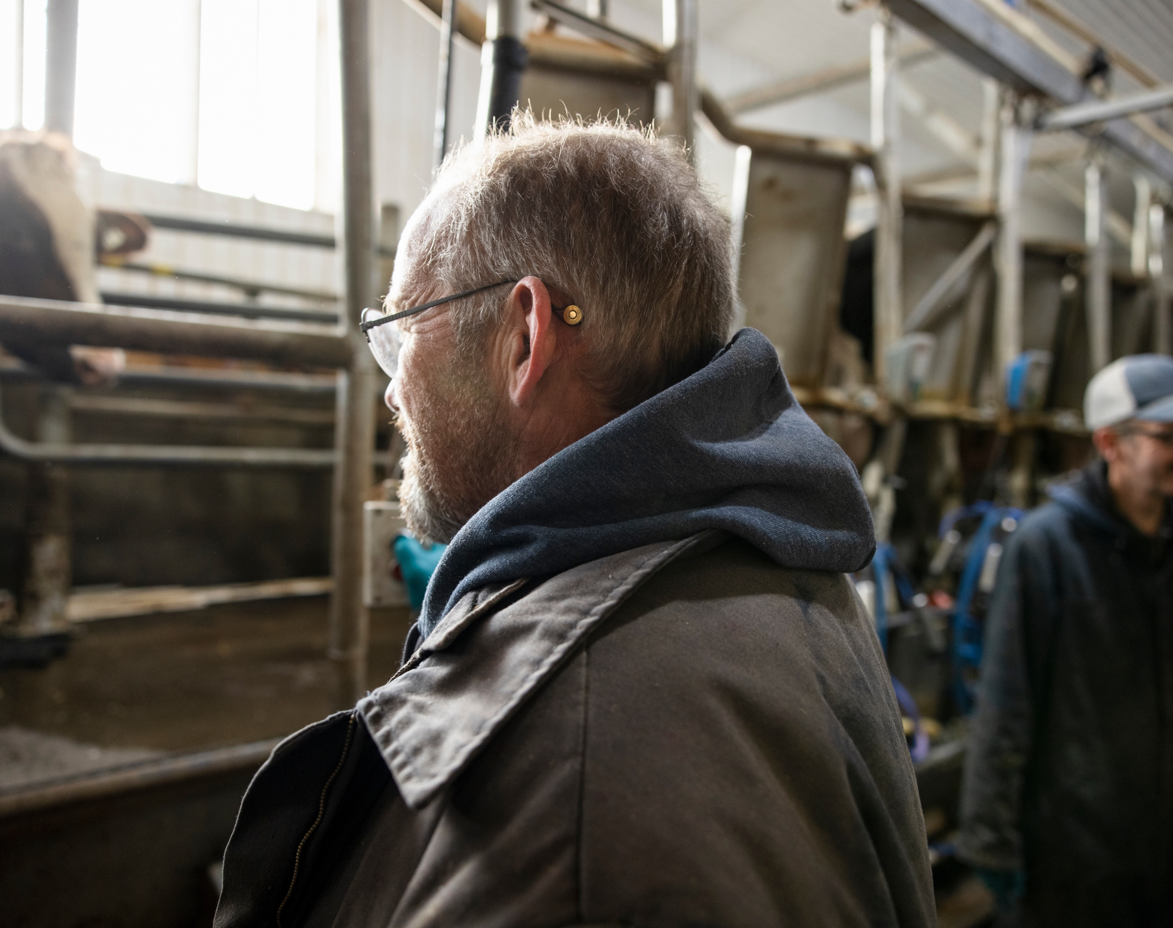
Some references
The images on this page are a good example of what we are looking for in the research.
Note:
You can personalize the images according to your needs. This is just an illustrative example.
Please delete this box before sending the brief.

Slide 19
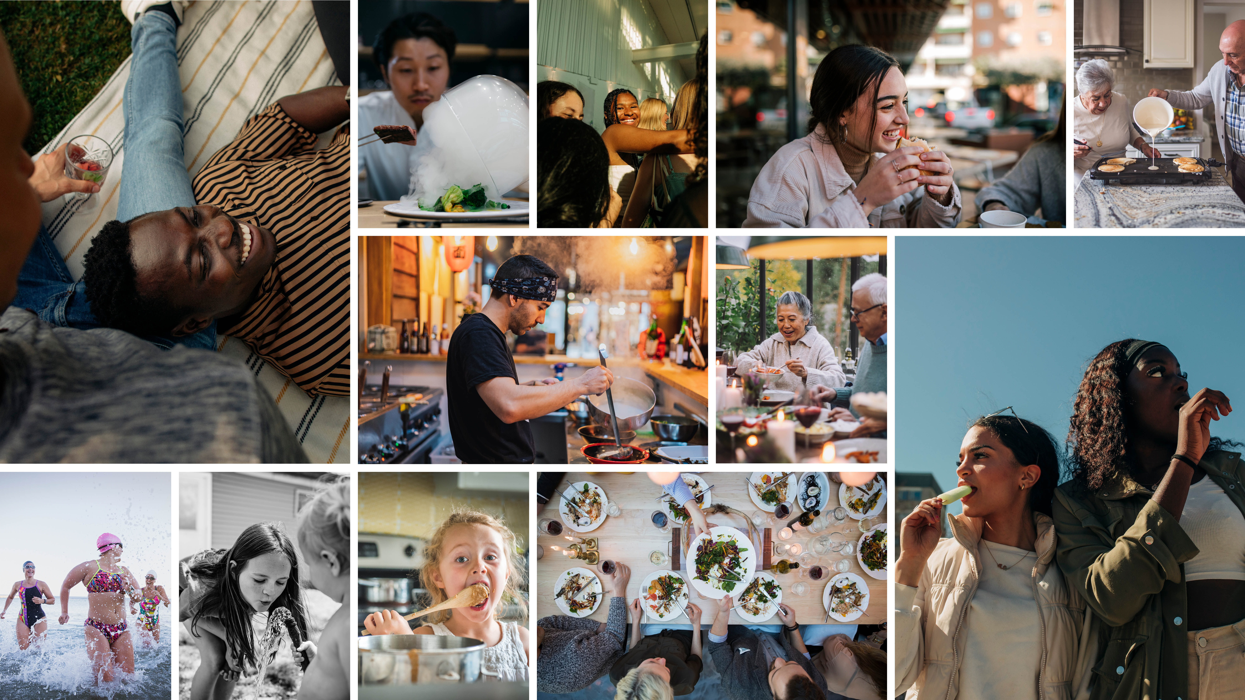
Our moodboard
Note:
Other examples you can share as references.
Please delete this box before sending the brief.

Slide 20
Image usage
In this section, you need to specify how many pictures
you need and the deadline.
An example:
Images are intended for promotional material on social media platforms. Commercial license is required.
This is just an illustrative example.
Please delete this box before sending
the brief.
This is just an illustrative example.
Please delete this box before sending the brief.

Slide 21
Requirements and deadline
In this section, it is important
to specify the intended usage and the desired licensing for the images.
An example:
5 images by Friday October 25th
This is just an illustrative example.
Please delete this box before sending
the brief.
This is just an illustrative example.
Please delete this box before sending the brief.

Slide 22
Checklist
Why is the photoshoot being conducted?
Who are the subjects of the photoshoot?
Where will the photoshoot take place?
What atmosphere is desired?
What is the desired style
and mood for the photos?
Are there any specific technical requirements for the photoshoot?
What is the date, time for the photoshoot?
Where will the images be used, and are there any licensing restrictions to consider?
Here is a list of questions that your
brief should address:

